Slide 1
Farmer Exchange
Created by:
Gerardo Sanchez, Ezequiel Martinez
Angel Ascencio, Nicholas Kasdjono

Slide 2



Our Mission
Small local farmers produce high quality products but may not have the time or resources to effectively expand their customer base.
Farmer exchange is a Web Application where farmers can connect to families and restaurants within and beyond their local communities.
We want to provide families and restaurants access to local farmers, so that they can have the opportunity to buy high quality products locally and not just from big chain supper markets who on average have an average of 40% of their produce aging paste their expiration date.

Slide 3
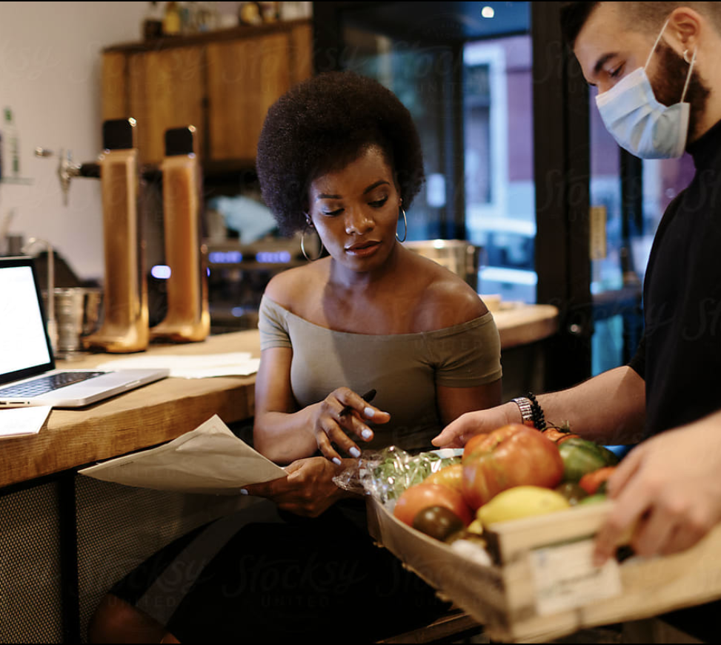
Farmers, restaurants and families can create a user profile
All users can post comments about one another regarding the products or experiences with one another (reviews)
Any two users can buy/trade products with one another.

Slide 4
Our Strategy
Data Base with MySql
Models/Seeds for users and product
Env file to secure the application
Routes in JS for the get/post functions
Handlebars for a dynamic website
Package JSON for increased fucntionality
Roles:
Gerardo Sanchez –
Ezequiel Martinez –
Angel Ascencio –
Nicholas Kasdjono -

Slide 5


Slide 6
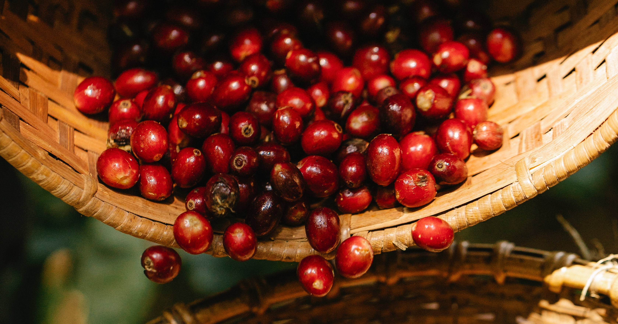

Slide 7


Slide 8


